Slide 1




DevOps Training
Lesson 01: Introduction to DevOps

Slide 2


Learning Objectives
By the end of this lesson, you will be able to:
State the principles of DevOps
Explain the challenges in the traditional approach
Describe how DevOps helps in overcoming challenges faced in
traditional approach
Describe the DevOps tools
Explain DevSecOps and it’s importance

Slide 3
Introduction to DevOps
DevOps Overview and Principles

Slide 4
DevOps
DevOps is short for Development and Operations. It concentrates on collaboration between developers and other parties involved in building, deploying, operating, and maintaining software systems.
Notes:
You will be working with different tools every day, so the basic tools we are covering today we will be covering the basic tools required for a devops engineer.
But if you are able to implement all the tools we are going to cover then you will be able to implement all the other tools.

Slide 5

History of DevOps
Patrick Debois, a Belgian consultant, project manager, and
agile practitioner is one among the initiators of DevOps.
A presentation on “10+ Deploys per Day: Dev and Ops
Cooperation at Flickr” helped in bring out the ideas for DevOps and resolve the conflict of “ It’s not my code, it’s your machines! ”
DevOps blends lean thinking with agile philosophy.
Notes:
He started the idea of DevOps and the people started to think yes this could be a great idea.
Some organizations have started to implement the DevOps and no longer require the build engineer the networking engineer, etc…

Slide 6
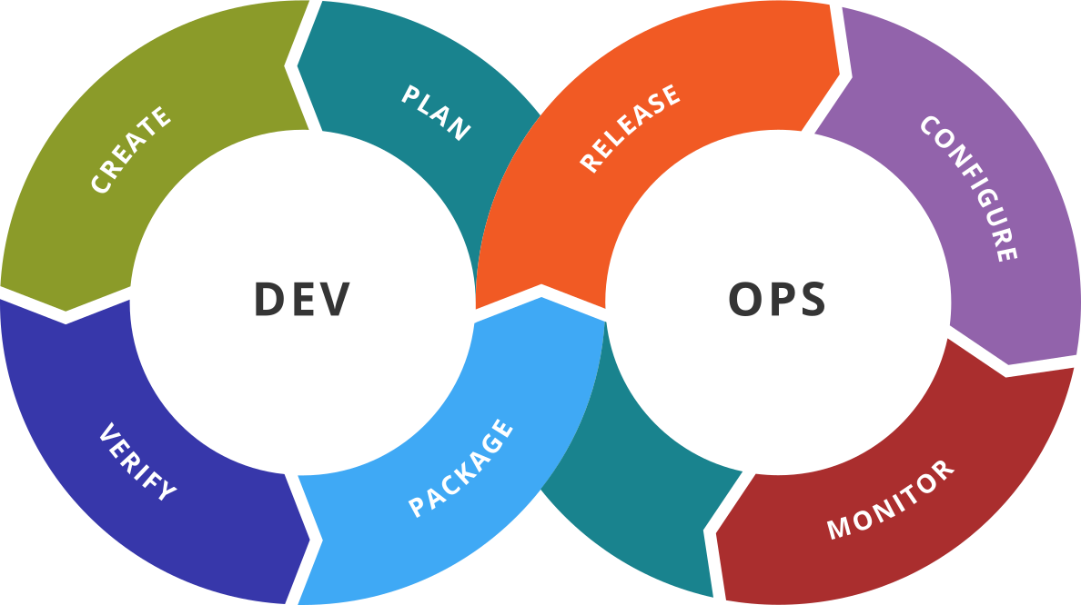


Overview of DevOps
DevOps is an agile relationship between development and IT operations
DevOps is the abbreviation for Development and Operations
The Development includes Plan, Create, Verify, and Package
The Operations include Release, Configure, and Monitor
Notes:
It is just a combination of two teams:
*Development team
*Operation side
Your organization can customize the DevOps tools so they can fit there need, the idea is to implement automation.

Slide 7
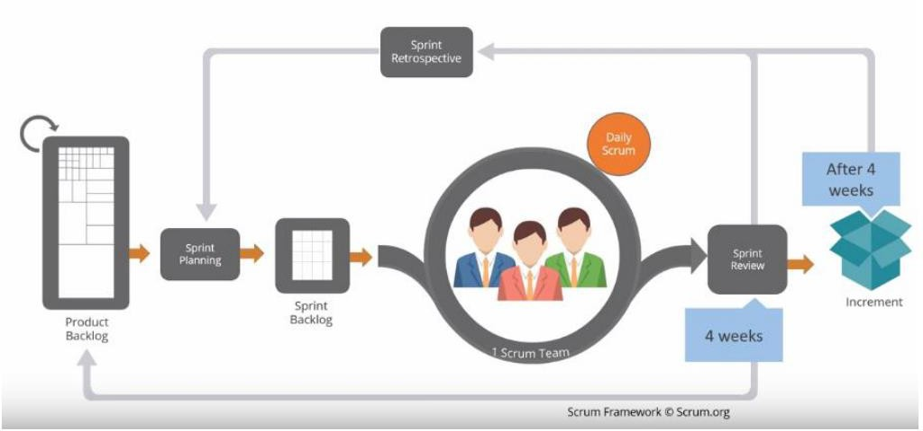
Agile Example: Scrum
Notes:
Agile and DevOps are interrelated with each other.
So lot of organization moved to Agile >> Scrum to enhance the use of DevOps.
Earlier organization used the waterfall method, 3-4 month development and then do the deployment, etc.. Which was very long and after that the code will be tested and deployed to development.
In case of Agile we are having a short release and delivery cycle, so for example we say each 4 weeks we will do all this cycle, so in these 4 weeks we will be doing the dev, testing, deployment.
Because when they implemented Agile they saw that the existing tools doesn’t let them implement Agile in the correct way.
So to solve this we use DevOps and here DevOps comes to the picture to solve this particular problem.
So in the end DevOps is very important for Agile.

Slide 8
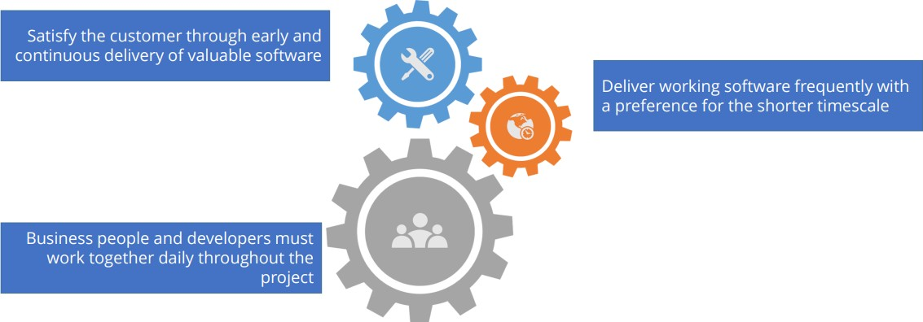
Relationship Between Agile and DevOps
Notes:
You cannot implement Agile without DevOps and vice versa.
We have to deliver to the production environment very frequently, so these are the DevOps advantages.
Dev and Ops needs to work closely together in order to achieve this goal.
As a DevOps engineer you need to support all the tools and provide them in order to help the team achieve there goal.
You need to provide solutions so they can do the build automation in one click for example, implement CI&CD, etc.…
During the deployment down time should be reduced for example, and for this we need to have DevOps tools.

Slide 9
Relationship Between Agile and DevOps
Replace non- human steps using tools
Improve the collaboration between all the teams
Relationship between Agile and DevOps
Automate to create a potentially shippable increment

Slide 10
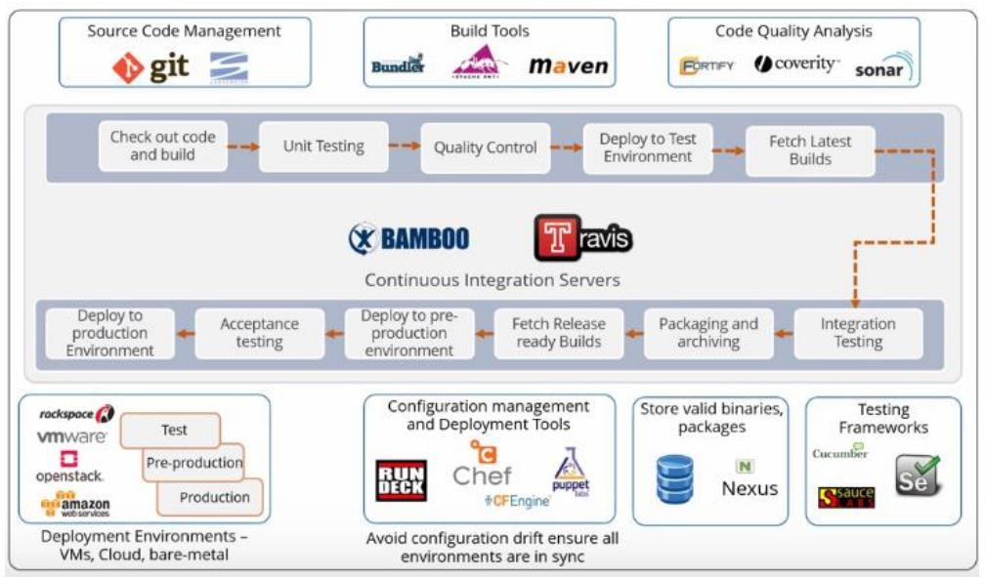
Agile and DevOps Example
Notes:
Here we can see the different tools.
You can deploy the source code on cloud / bare-metal / etc, you can deploy the source code in different region if you want (France, EU, etc…)

Slide 11










DevOps Toolchains
Monitoring
Performance
Releasing into
Production
Building
Applications
Code Development and Unit
Testing
Configuration Management
Integration and Performance Testing
Packing the Application

Slide 12



DASA DevOps Principles
Cross-functional autonomous teams
Customer-centric action
Create with the end in mind
End-to-end responsibility
Continuous improvement
Automate everything you can
Notes:
DASA (https://www.devopsagileskills.org/) is an independent and open association supporting the development of high-performance IT organizations through agile DevOps initiatives.
DASA offers thought leadership as well as practical guidance for competence development for professionals and organizations.
It provide guidelines for DevOps and Agile.
Customer: You need to keep in mind the Customer (What is the requirement of the business?)
End to end responsibility: Support the dev team , delivery of the source
Create with end in mind: what is the end result you are trying to achieve
Cross functional autonomous teams: you need to collaborate with others in order to implement DevOps efficiently

Slide 13


Case Study
Amazon switched to DevOps at the development phase of their web
services, popularly known as AWS.
Notes:
Lambda function, API pipelines, buckets, etc… can be used to facilitate devops part
How Amazon is managing so many servers???? (DevOps)

Slide 14
Challenges in the Traditional Approach

Slide 15


Waterfall Method
Most of the development teams use waterfall method, which is time- consuming because of the larger size of the developer team, testers, and the code involved.
Notes:
The disadvantage of waterfall development is that it does not allow much reflection or revision. Once an application is in the testing stage, it is very difficult to go back and change something that was not well-documented or thought upon in the concept stage.
Long development stages.
The major disadvantages of the Waterfall Model are as follows:
No working software is produced until late during the life cycle.
High amounts of risk and uncertainty.
Not a good model for complex and object-oriented projects.
Poor model for long and ongoing projects.
Not suitable for the projects where requirements are at a moderate to high risk of changing. So, risk and uncertainty is high with this process model.
It is difficult to measure progress within stages.
Cannot accommodate changing requirements.
Adjusting scope during the life cycle can end a project.
Integration is done as a "big-bang. at the very end, which doesn't allow identifying any technological or business bottleneck or challenges early.

Slide 16

Productivity
Codes that are large and bundled into release will result in jammed production and lower the productivity.

Slide 17

Difficult to Achieve Goal
Less investment on resources and constant work make it difficult for the developers to achieve goal or an outcome.

Slide 18


Investment in Schedule Planning Systems
More money is invested in schedule planning systems which are sensitive and inaccurate. As a result, it consumes more time to manage the systems.

Slide 19







Constantly Changing Challenges
Cost Incurring
Networking Related
DevOps Culture
Tools Compatibility
Software Tools
Notes:
Challenges to implement DevOps

Slide 20
Types of Constantly Changing Challenges
DevOps
Culture
Adapts to continuous changes : People’s resistance, organization culture and pair-programming
Software Tools
Preference on tools across teams, standardization of tools across the organization in terms of
licensing, version incompatibilities, maintenance and support
Tools
Compatibility
Existence of legacy systems. Hybrid environments and tools must be cloud ready
Network Related
Issues
Internet Connectivity, Data Center Connectivity, Virtual LANs, Cloud Connectivity
Cost Related Issues
New hardware requirements, software licensing, training, reduced efficiency while learning
Notes:
Already covered

Slide 21
DevOps Approach to the Challenges

Slide 22
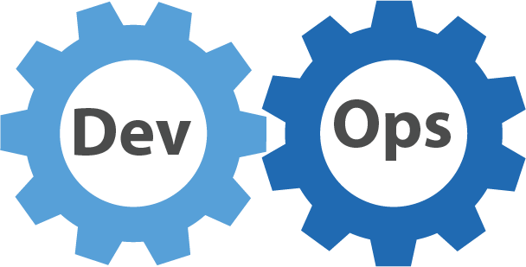
DevOps Way to Overcome Challenges
Reduction in the code size delivery results in increased productivity
Smaller batch sizes, dedicated teams, and automated processes make scheduling simpler to operate
Batch sizes are divided into small cells. Each cell gathers its own data, reducing the size of the reports
Identifies productive and loss areas in the process. As a result, an
organization can focus more on their goals

Slide 23
Overview of DevOps Tools

Slide 24

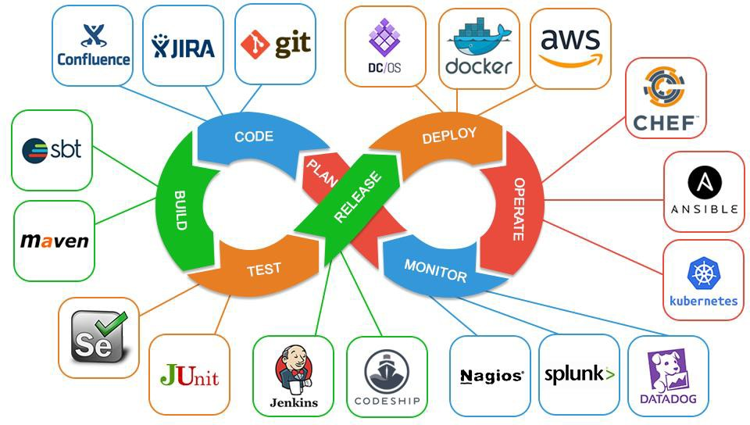
DevOps Tools
To implement DevOps and work within the DevOps setup, the various tools required are:
Notes:
Here we can see the various tools

Slide 25
Best Practices for DevOps
Training for both DevOps
and cloud computing
Proper funding for
DevOps
Security
Automated performance testing
Proper DevOps tools selection
Service and Resource governance

Slide 26

DevOps and Cloud Computing Training
Proper training in DevOps and cloud computing will lead to better understanding and help resolve challenges in DevOps environment.

Slide 27


Security
Security should be part of the automated testing. It should be built into continuous integration and deployment processes during the migration to cloud-based platform.

Slide 28
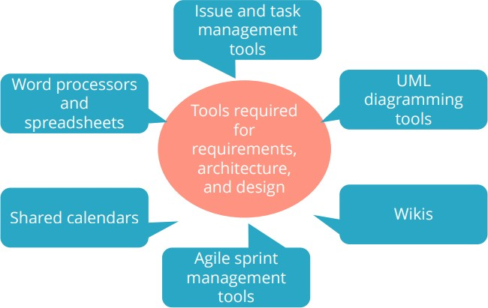
Requirements Tools
Tools are used to share the files and communicate within the team and other teams.
diagram

Slide 29
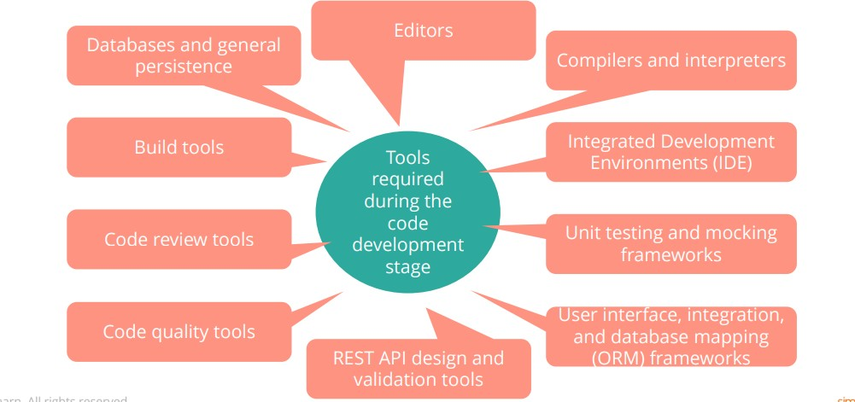
Code Development Tools
Databases and general persistence tools

Slide 30
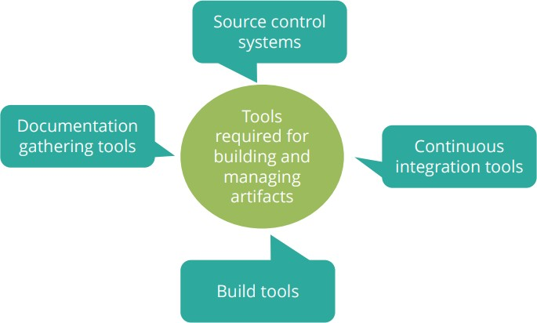
Artifact Creation Tools

Slide 31
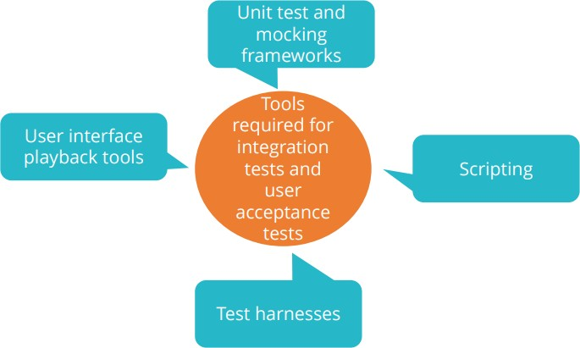
Testing Tools
Scripting tools
Test harness tools

Slide 32
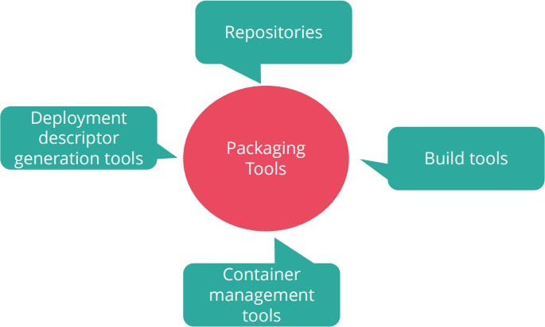
Packaging Tools
Repository
tools
Tools required for packaging during production

Slide 33
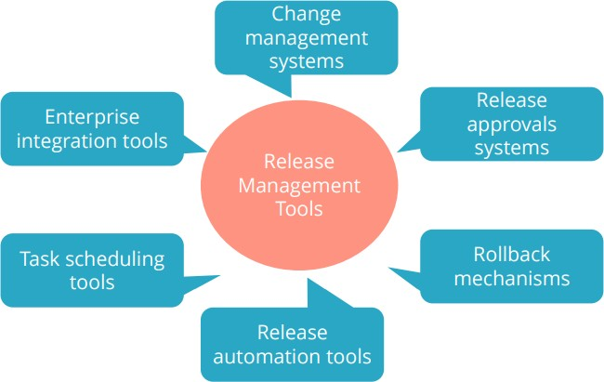
Release Management Tools
Tools required for release management in production

Slide 34
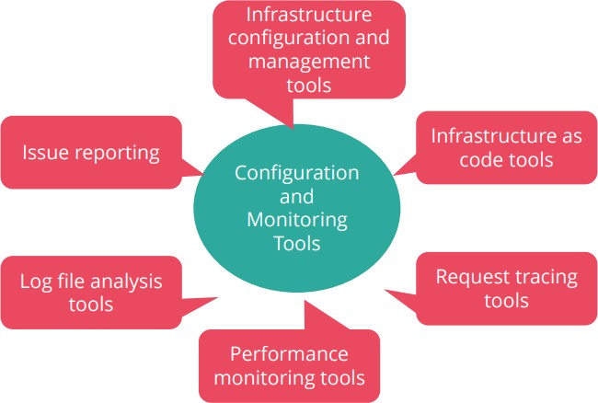
Configuration and Monitoring Tools
Issue reporting tools

Slide 35
DevSecOps and It’s importance

Slide 36
DevSecOps
DevSecOps is the ideology of integrating security practices within the DevOps culture.
01
Creates a ‘Security as Code’ Culture
02
Creates a flexible collaboration between the team members
DevSecOps
03
Bridges traditional gaps between IT and
Security
04
Aims to embed security in every part of the development process
Notes:
DevSecOps is a trending practice in application security (AppSec) that involves introducing security earlier in the software development life cycle (SDLC).
It also expands the collaboration between development and operations teams to integrate security teams in the software delivery cycle.
SonarLint and SonarQube
OWASP
Softwares that scans the infrastructure
HTTPS/SSL

Slide 37
DevSecOps Manifesto
Leaning in over Always Saying “no”
Data & Security Science over Fear, Uncertainty and Doubt
Open Contribution & Collaboration over Security-Only Requirements
Consumable Security Services with APIs over Mandated Security Controls & Paperwork
Business Driven Security Scores over Rubber Stamp Security
Red & Blue Team Exploit Testing over Relying on Scans & Theoretical Vulnerabilities
24*7 Proactive Security Monitoring over Reacting after being informed of an incident
Shared Threat Intelligence over Keeping Info to Ourselves
Compliance Operations over Clipboards & Checklists

Slide 38
Workflow of DevOps and DevSecOps
A Developer writes a code for a feature within the version control management
system
The required changes are committed to the version control management system
Another Developer retrieves the code from the version control management system
and performs analysis of the code to identify security threats
An environment is created using any management tool such as puppet or chef. The
application is deployed and security configurations are applied to the system.

Slide 39
Workflow of DevOps and DevSecOps
A test automation suite is executed against the deployed application on factors like
UI, integration, security tests, and APIs
If the application passes the test, it is deployed to the production environment
The newly production environment is monitored continuously to identify any active security threats

Slide 40
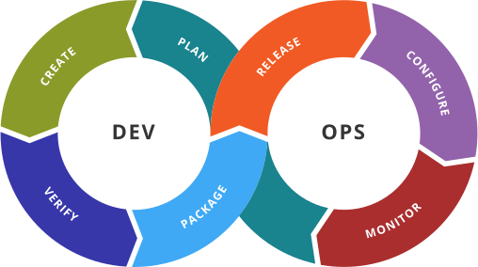
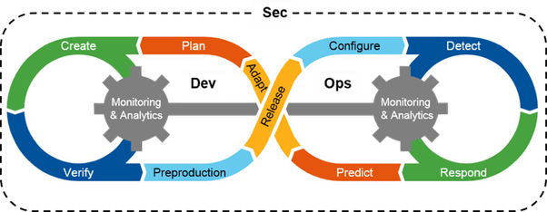
DevOps vs. DevSecOps
Features:
Speed
Rapid delivery
Scaled and less secured
Features:
Agility
Security automation Security as code

Slide 41

Key Takeaways
You are now able to:
State the principles of DevOps
Explain the challenges in the traditional approach
Describe how DevOps helps in overcoming challenges faced in
traditional approach
Describe the DevOps tools
Explain DevSecOps and it’s importance

Slide 42

Knowledge Check
Notes:
Create an account on AWS, AZURE or Google Cloud

Slide 43

Which one of the following methodologies has least impact on DevOps methodology?
Knowledge Check
1
a.
Lean Manufacturing
b.
Agile Software Delivery
c.
Waterfall Software Delivery
d.
Continuous Software Delivery

Slide 44

Which one of the following methodologies has least impact on DevOps methodology?
Knowledge Check
1
a.
Lean Manufacturing
b.
Agile Software Delivery
c.
Waterfall Software Delivery
d.
Continuous Software Delivery
The correct answer is
d. Continuous Software Delivery

Slide 45
Which one of the following techniques makes DevOps a successful methodology to develop
and deliver software?
Knowledge Check
2
a.
DevOps helps in organizing the teams and organizational mission
b.
DevOps helps in creating the software with built-in quality and monitoring
c.
DevOps helps to quickly identify, fix and learn from errors
d.
All of the above

Slide 46
Which one of the following techniques makes DevOps a successful methodology to develop
and deliver software?
Knowledge Check
2
a.
DevOps helps in organizing the teams and organizational mission
b.
DevOps helps in creating the software with built-in quality and monitoring
c.
DevOps helps to quickly identify, fix and learn from errors
d.
All of the above
The correct answer is
d. All of the above

Slide 47
Which is the best technique to convert normal changes into standard changes?
Knowledge Check
3
a.
Use the existing track record of successful automated deployments with standard changes
b.
Negotiate with release managers
c.
Publicly complain about bureaucracy and make everyone be aware of it
d.
Make sure normal changes are very carefully deployed to the production

Slide 48
Which is the best technique to convert normal changes into standard changes?
Knowledge Check
3
a.
Use the existing track record of successful automated deployments with standard changes
b.
Negotiate with release managers
c.
Publicly complain about bureaucracy and make everyone be aware of it
d.
Make sure normal changes are very carefully deployed to the production
The correct answer is
a. Use the existing track record of successful automated deployments with standard changes

Slide 49
Which is the widely reusable asset to reinforce information security?
Knowledge Check
4
a.
Data Storage Systems
b.
Tools handling the logging of sensitive client information
c.
Transfer of data between clients and software
d.
All of the above

Slide 50
Which is the widely reusable asset to reinforce information security?
Knowledge Check
4
a.
Data Storage Systems
b.
Tools handling the logging of sensitive client information
c.
Transfer of data between clients and software
d.
All of the above
The correct answer is
d. All of the above

Slide 51
What is the benefit of using feature toggles embedded in configuration of the application
during fixing errors?
Knowledge Check
5
a.
Easiest way to fix a problem
b.
Don’t have to correct erroneous pieces immediately during deployment
c.
DevOps team can take time to properly identify root cause of an issue and improve the techniques
d.
All of the above

Slide 52
What is the benefit of using feature toggles embedded in configuration of the application
during fixing errors?
Knowledge Check
5
a.
Easiest way to fix a problem
b.
Don’t have to correct erroneous pieces immediately during deployment
c.
DevOps team can take time to properly identify root cause of an issue and improve the techniques
d.
All of the above
The correct answer is
d. All of the above

Slide 53

Thank You

